Slide 1

Communication Networks I
Lecture 11
Advanced Computer Networks (ACN) 545
Mr. Thilak de Silva.
BSc. Eng., MSc, CEng, FIE(SL), FIET(UK), CITP(UK), MBCS(UK), MIEEE (USA)

Slide 2
Today's Agenda
PSTN
Signaling
ISDN
PDSN
Internet Connections

Slide 3
Session Outcomes
At the end of this session you will understand about the Public Switch Telephone Network, Signaling, Integrated Services Digital Network and Internet connections.

Slide 4
PSTN – Public Switch Telephone network
PSTN contains an Access network, Transmission Network, Switching and Signaling.
Use TDM System → Time Slots.
It’s a Real time dedicated connection.
The bandwidth is wasted in two copper wires in the Access networks as well as in between exchanges.

Slide 5
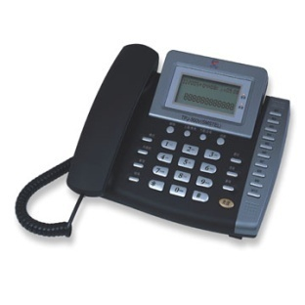
PSTN – Public Switch Telephone network
Waste of Bandwidth –
Use only 4 Khz
Real time dedicated connection
2 Copper Wires
TDM - TS
64 Kbps
Circuit Switching
Because all the time 64Kpbs are not used bandwidth is wasted
Occupancy
64 Kbps
Idle
Time

Slide 6
Signaling Between Exchanges
Has two types,
    Channel Associated Signaling – C5, R2
    Separate Signaling Network – C7

Slide 7
Channel Associated Signaling
In PSTN if data transmission is needed first we need to convert the data signal in to an analog signal by using a modem.
V. Standards are used when sending data through a PSTN network.
9.6 kbps
14.4 Kbps
19.2 Kbps
28.2 Kbps
54 Kbps
Modem
Data
V.35

Slide 8
Channel Associated Signaling
Here TS 16 (16th Time slot) of a Primary Multiplexer is allocated for signaling.
We can directly connect the customer equipment to the Multiplexer. (bypassing the exchange) That is called a leased line connection.

Slide 9

Leased Line
We can directly connect the customer equipment to the Multiplexer. (bypassing the exchange) That is called a leased line connection.
No Switching.
Point to point connection.
Leased line
64Kbps
MUX
Higher Order MUX
Transmission Network
Switch

Slide 10
Leased Line
Data Mux s (A Special primary mux ) can be used to connect leased lines.
Cost of leased line connections are very expensive compared to dial-up connections.
N * 64 Kbps
Data MUX
2Mbps
Leased Circuits
Inputs are configurable

Slide 11
Separated Signaling Network – C7
Signaling network is separated from the switching network.
Signaling network became a packet switched network.
Therefore C7 signaling supports transmission of both voice and data through the PSTn network.

Slide 12
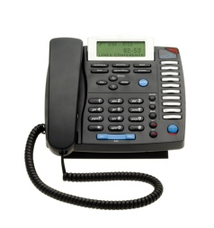
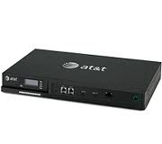

ISDN - Integrated Services Digital Network
64 Kbps
Network Interface
Exchange
64 Kbps
2 * 64 Kbps
+ 16 Kbps for signaling
TA
Analog Phone
OR
64 Kbps
Digital Phone

Slide 13
ISDN - Integrated Services Digital Network
ISDN users circuit switching
An ITU-T standard.
Two physical interfaces,
  BRI -> 2B+D
  PRI -> 30B+D
BISDN – Broadband ISDN
  Provides up to 155 Mbps of speed
  Did not actually implemented

Slide 14
PSDN – Public Switch Data network
Introduced by ITU-T
Eg: x.25
Network Layer
Data Link Layer – LAP-B
Physical layer
2 copper wires
X.25
Packet switch
Network Interface
Network Interface
LAP-B
X.25

Slide 15
PSDN – IP
ISOC developed another public switch network called IP network.
They used routers instead of packet switches. A Router can be placed either in customer premises or in service providers premises.

Slide 16

PSDN – IP
IP
This is normally a private network
HDLC, PPP
RS -232

Slide 17
Getting Internet Connection
A customer need a service provider to get connected to internet/ public network.
Private Network
Public Network
ISP
Dial up

Slide 18
Getting Internet Connection
Internet
PSTN
Modem
Modem band + Remote Access server
ISP
Customer

Slide 19
Getting Internet Connection
ISP a need to get a leased line from a bigger Service provider.
Small ISP Telecom Tier 1 Operators

Slide 20
Getting Internet Connection
2 copper wires
DSLAM
PE router
ADSL modem bank
ADSL modem
MPLS

Slide 21

Getting Internet Connection
Instead of two copper wires we can have a fiber ring in the access network.
Can get higher bit rates.
PON , FTTH, FTTN .
Metro Ethernet box
PE Routers

Slide 22
Thank You…

