Slide 1
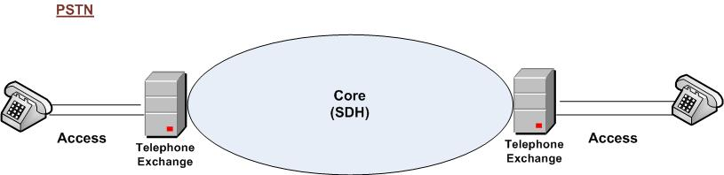
Public Switch Telephone Network

Slide 2
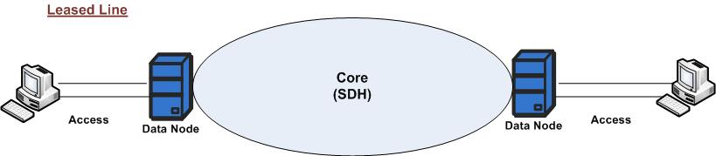
Leased Line

Slide 3
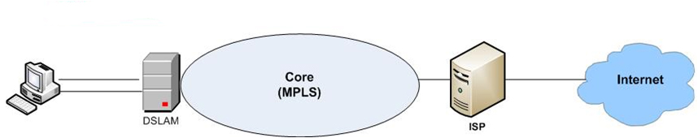
ADSL (Internet Only)

Slide 4
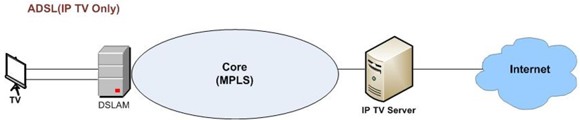
ADSL (IP TV Only)

Slide 5
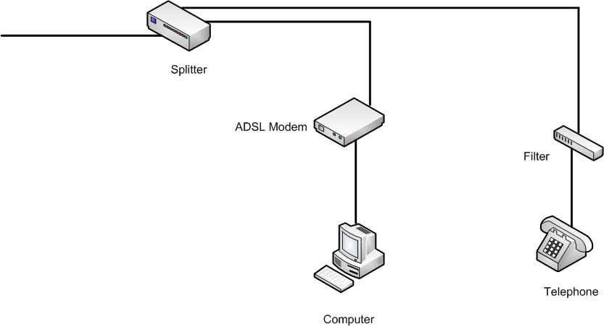
ADSL - Internet only

Slide 6
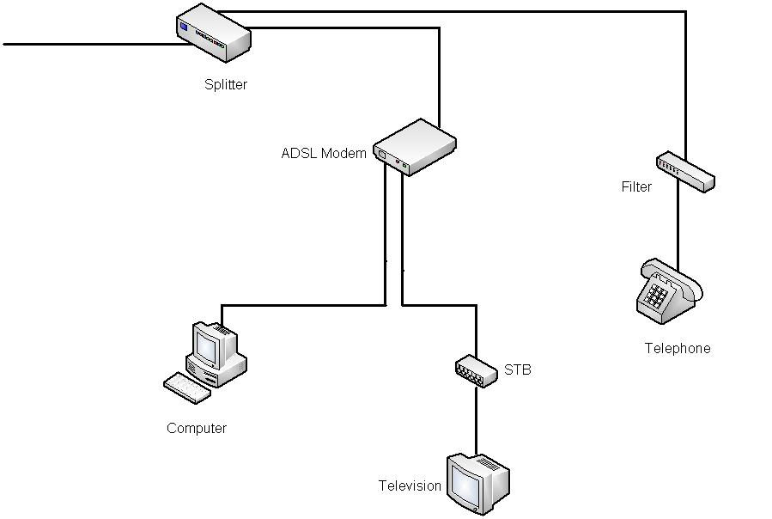
ADSL - Internet+Peo TV

Slide 7
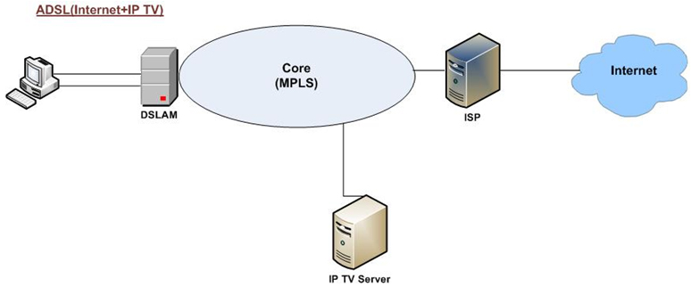
ADSL (Internet + IP TV)

Slide 8
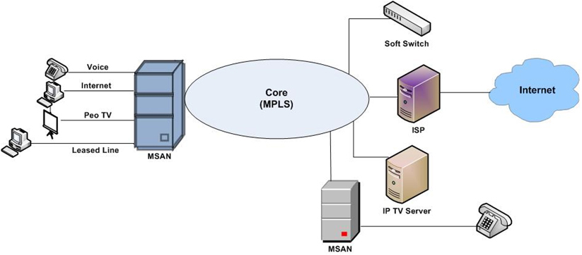
NGN

Slide 9
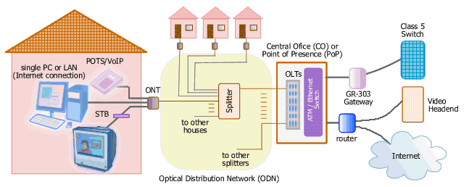
Access Technologies
FTTH (Fibre To The Home)
9

